Slide 1


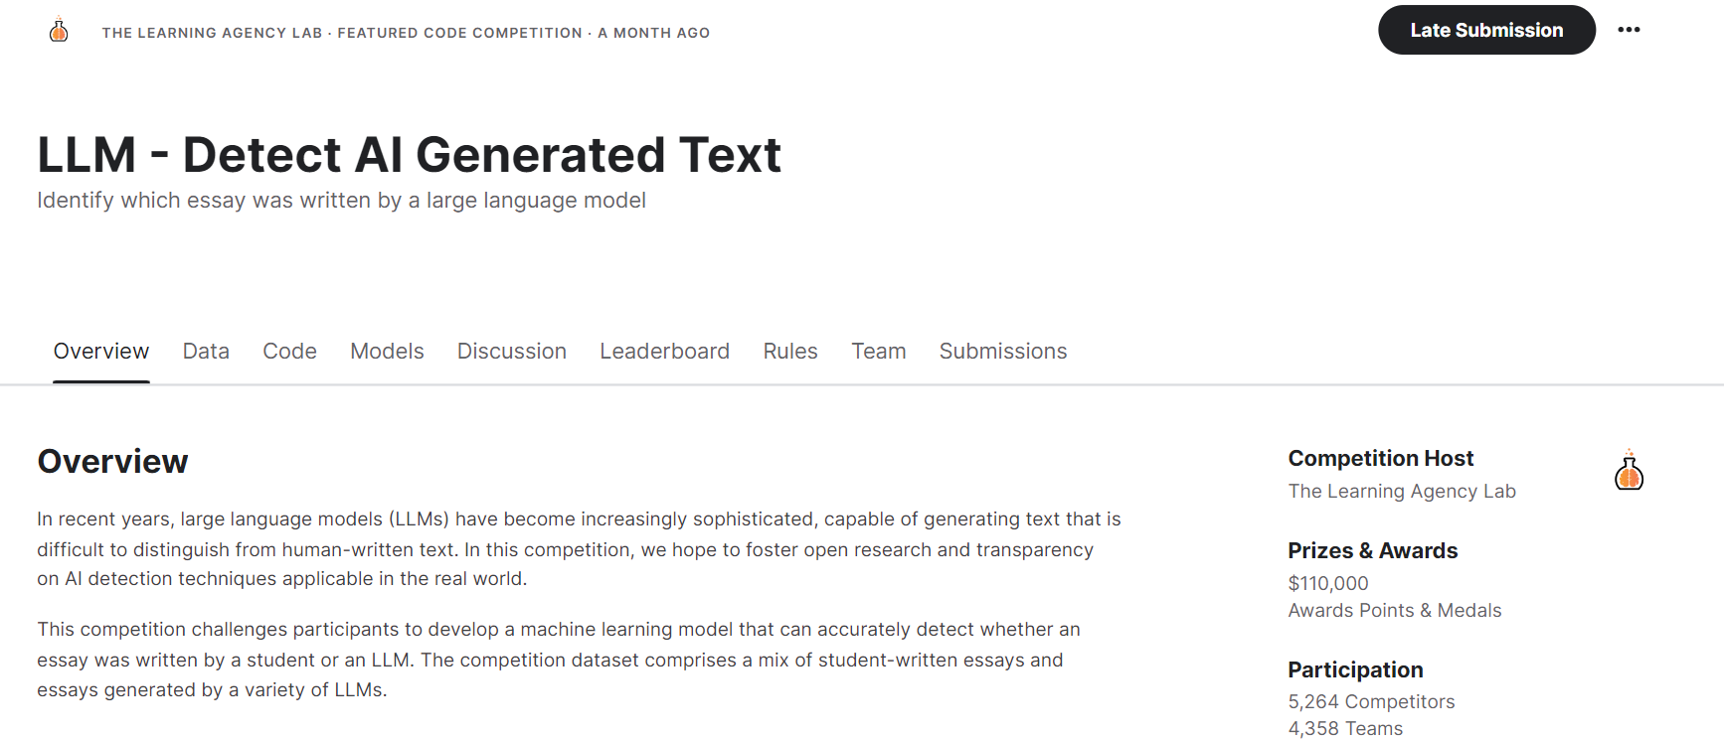

7th Place Solution in Efficiency Prize
Yellowleaf
Notes:
Recommending picking out he most interesting and important parts from your documentation.

Slide 2
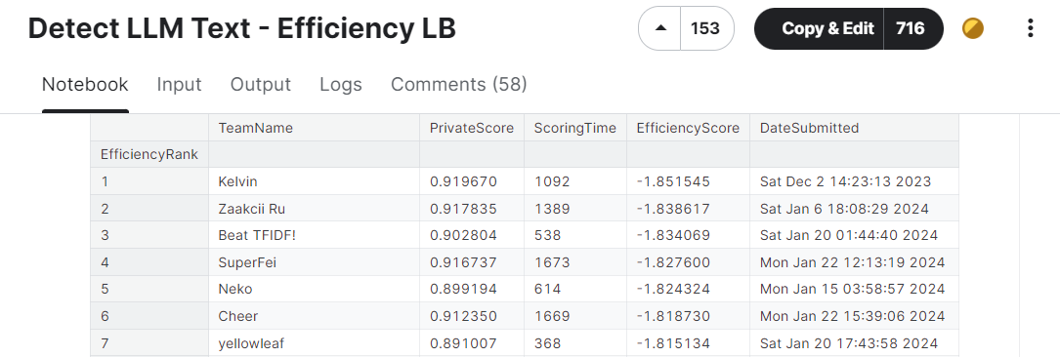

Slide 3
Agenda
Problem description
Data
Solution
Time Optimization
Results
Code
Reference

Slide 4
Problem description

Slide 5
Problem description
Determine whether a given essay was student written or LLM(Large Larguage Model)generated

Slide 6
Data
The mainstream approach in competition is to seek or generate diverse datasets of student writing and large language model-generated data for data augmentation.
Many Kagglers have generously shared their own datasets.
Our approach also involves searching for external open-source data, and we have utilized the following external datasets：
https://www.kaggle.com/datasets/thedrcat/daigt-v2-train-dataset
https://www.kaggle.com/datasets/alejopaullier/argugpt
https://www.kaggle.com/datasets/kagglemini/train-00000-of-00001-f9daec1515e5c4b9
https://www.kaggle.com/datasets/pbwic036/commonlit-data
https://www.kaggle.com/datasets/wcqyfly/argu-train

Slide 7
Solution

Slide 8
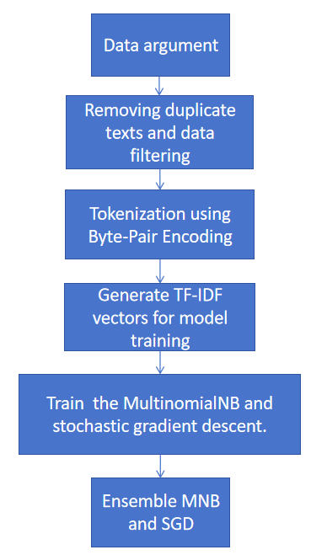
Solution
The pipeline of our solution
Removing duplicate text and data filtering
This part is the same as the public work.
Tokenization using Byte-pair Encoding
This part is the same as the public work.
public work: https://www.kaggle.com/code/batprem/llm-daigt-excluded-prompts?scriptVersionId=158926419

Slide 9
Solution
Generate TF-IDF vectors for model training
We adjusting parameters such as min_df, max_df, and max_features to effectively reduce the feature dimensionality and minimize the impact of noisy data.
In the later stages of the competition, the discussion forum shared techniques for tuning TF-IDF, including adjusting parameters such as min_df, max_df, and max_features. These techniques proved to be beneficial for feature selection in our approach.
Discussion Forum Link: https://www.kaggle.com/competitions/llm-detect-ai-generated-text/discussion/468908

Slide 10
Solution
Train the MultinomialNB and stochastic gradient descent
We adjusted the parameter alpha which means the additive smoothing for MultinomialNB and the train steps for SGD.
Ensemble MNB and SGD
We have attempted to combine Multinomial Naive Bayes (MNB) and Stochastic Gradient Descent (SGD) using different weights.

Slide 11
Time Optimization
Reduced feature size as mentioned above.
We adjusting parameters such as min_df, max_df, and max_features.
Remove time-consuming models.
We found that after using lightgbm and catboost, not only does it take more time, but the LB score also decreases. We decided to remove these two models.
However, the fact proves that this choice is wrong, which makes the PB score very low. But fortunately, we have the opportunity to obtain Efficiency Price.

Slide 12
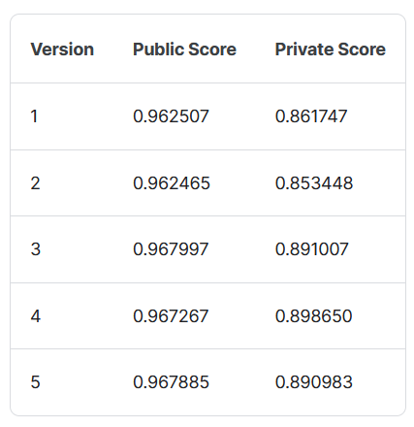
Results
Details of the submission

Slide 13
Code
Our code can be access by kaggle or github.
Kaggle Link: https://www.kaggle.com/code/wcqyfly/fork-of-fork-of-fork-of-llm-daigt-analyse-e-db6333
The annotated training and testing code can be found in version 6.
The original submission code can be found in version 3.
Note: It should be noted that because the number of test sets is less than 3, running all directly will cause the code to report an error, but after submitting, when the test set is replaced with a hidden test set, the code will be run correctly and get the result.

Slide 14
Code
Github Link: https://github.com/wcqy001028/LLM-Detect-AI-Generated-Text
Note: If the number of data in the test_essays.csv is less than 5, the min_df is set to 1 and the model is not trained which only used for debugging. Conversely, when the number of data in test_essays.csv is greater than 5, the min_df is set to 2 and the model will be trained and will generate prediction results.

Slide 15
Reference
1.https://www.kaggle.com/code/batprem/llm-daigt-excluded-prompts?scriptVersionId=158926419
2.https://www.kaggle.com/datasets/thedrcat/daigt-v2-train-dataset
3.https://www.kaggle.com/datasets/alejopaullier/argugpt
4.https://www.kaggle.com/datasets/kagglemini/train-00000-of-00001-f9daec1515e5c4b9
5.https://www.kaggle.com/datasets/pbwic036/commonlit-data
6.https://www.kaggle.com/datasets/wcqyfly/argu-train
7.https://www.kaggle.com/competitions/llm-detect-ai-generated-text/discussion/468908
8.https://www.kaggle.com/competitions/llm-detect-ai-generated-text/discussion/455711

Slide 16
Question and Answer

